Slide 1
Select ONE of these templates. 2. Copy (duplicate slide) 3. Paste into new PPT file. 4. SAVE as new. 5. Make it Your own: (Add/Remove logos, sections and headings as appropriate.)

Slide 2
To check the size of your poster
Go to the “Design” Tab
Notice the “Slide Size” icon on the far right
Choose “Custom”
Determine your layout portrait or landscape
Set your poster to be approx. 30” x 40”, or 36” x 48” depending on how large your easel is. This poster is 36” x 42”

Slide 3
Poster Title
Authors Names, Dept
CURS Summer Scholars Program, Augusta University
DISCUSSION
INTRODUCTION
REFERENCES
METHODS
ACKNOWLEDGEMENTS

Slide 4
Poster Title
Authors Names, Dept
CURS Summer Scholars Program, Augusta University
INTRODUCTION
METHODS
DISCUSSION
Section Header
Section Header
Section Header

Slide 5
Poster Title
Authors’ Names, Dept
CURS Summer Scholars Program, Augusta University
INTRODUCTION
METHODS
DISCUSSION
Section Header
Section Header
Section Header

Slide 6
Poster Title
Author Names and Departments
Augusta University, Augusta, Georgia
INTRODUCTION
RESULTS
Insert Image, Table, or Figure
Figure 1.Be sure to include figure captions. Refer to your figures in the text (e.g., see Fig. 1)
Insert Image, Table, or Figure
CONCLUSIONS
LICHANDLER@augusta.edu
Insert Image, Table, or Figure
LICHANDLER@augusta.edu
Figure 1.Be sure to include figure captions. Refer to your figures in the text (e.g., see Fig. 1)
Figure 1.Be sure to include figure captions. Refer to your figures in the text (e.g., see Fig. 1)
METHODS
SELECTED REFERENCES
ACKNOWLEDGEMENTS

Slide 7
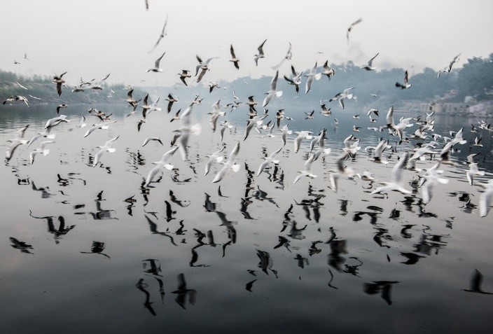
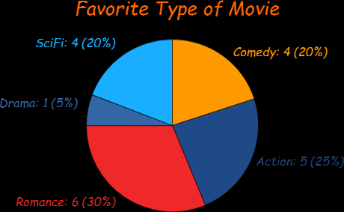
Poster Title
Author Names and Departments
Augusta University, Augusta, Georgia
INTRODUCTION
RESULTS
Figure 4. Description of Figure 4 data
CONCLUSIONS
LICHANDLER@augusta.edu
LICHANDLER@augusta.edu
METHODS
Figure 1. Description of Figure 1
Text…..
Sample
Process
here
Figure 2. Description of Figure 2
Text…..
Figure 3. Description of Figure 3
Text…..
SELECTED REFERENCES
ACKNOWLEDGEMENTS

